Slide 1

CSE 473: Pattern Recognition

Slide 2
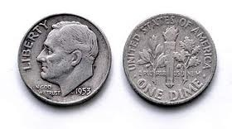
Hidden Markov Model

Slide 3
Main issues using HMMs
Evaluation problem.
Given the HMM M=(A, B, π) and the observation sequence O=o₁ o₂ ... o_{K} , calculate the probability that model M has generated sequence O.
O=o₁...o_{K} denotes a sequence of observations o_{k}∈{v₁,…,v_{M}}.

Slide 4
Main issues using HMMs
Decoding problem.
Given the HMM M=(A, B, π) and the observation sequence O=o₁ o₂ ... o_{K} , calculate the most likely sequence of hidden states s_{i} that produced this observation sequence O.
O=o₁...o_{K} denotes a sequence of observations o_{k}∈{v₁,…,v_{M}}.

Slide 5
Main issues using HMMs
Learning problem.
Given some training observation sequences O=o₁ o₂ ... o_{K} and general structure of HMM (numbers of hidden and visible states), determine HMM parameters M=(A, B, π) that best fit training data.
O=o₁...o_{K} denotes a sequence of observations o_{k}∈{v₁,…,v_{M}}.

Slide 6
The evaluation Problem
Given the HMM M=(A, B, π) and the observation sequence O=o₁ o₂ ... o_{K} , calculate the probability that model M has generated sequence O.
where, O=o₁...o_{K} denotes a sequence of observations o_{k}∈{v₁,…,v_{M}}.

Slide 7
The evaluation Problem
Given the HMM M=(A, B, π) and the observation sequence O=o₁ o₂ ... o_{K} , calculate the probability that model M has generated sequence O.
where, O=o₁...o_{K} denotes a sequence of observations o_{k}∈{v₁,…,v_{M}}.
Alternately, find P(O|M) or P(o₁ o₂ ... o_{K}|M)

Slide 8
The evaluation Problem
Given the HMM M=(A, B, π) and the observation sequence O=o₁ o₂ ... o_{K} , calculate the probability that model M has generated sequence O.
where, O=o₁...o_{K} denotes a sequence of observations o_{k}∈{v₁,…,v_{M}}.
Alternately, find P(O|M) or P(o₁ o₂ ... o_{K}|M)
For simplicity we write it as P(O) or P(o₁ o₂ ... o_{K})

Slide 9
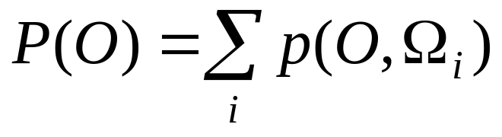
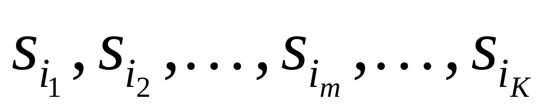
The evaluation Problem
Objective:
find P(O) or P(o₁ o₂ ... o_{K})
where, Ω_{i} is a possible state sequence

Slide 10
The evaluation Problem
Objective:
find P(O) or P(o₁ o₂ ... o_{K})
where, Ω_{i} is a possible state sequence
There are N^{K} possible state sequences!!

Slide 11
The evaluation Problem
Objective:
find P(O) or P(o₁ o₂ ... o_{K})
where, Ω_{i} is a possible state sequence
Complexity is O(N^{K} )

Slide 12
Alternate Solution to The evaluation Problem
Use Forward-Backward HMM algorithms for efficient calculations.
Define the forward variable α_{m}(i) as the joint probability of
  the partial observation sequence o₁ o₂ ... o_{m} and
  the hidden state at time m is s_{i} :
α_{m}(i)= P(o_{1,} o₂ ... o_{m ,} q_{m}= s_{i} )

Slide 13
Trellis representation of an HMM
o₁ o_{m} o_{m+1} o_{K} = Observations
s₁
s₁
s₁
s₁
s₂
s₂
a_{1j}
s₂
s₂
a_{2j}
s_{i}
s_{i}
a_{ij}
s_{i}
s_{j}
a_{Nj}
s_{N}
s_{N}
s_{N}
s_{N}
Time= 1 m m+1 K

Slide 14
Trellis representation of an HMM
o₁ o_{m} o_{m+1} o_{K} = Observations
s₁
α_{m}(1)
s₁
s₁
a_{1j}
s₂
α_{m}(2)
s₂
s₂
a_{2j}
s_{i}
α_{m}(i)
s_{i}
a_{ij}
α_{m+1}(j)
a_{Nj}
s_{N}
α_{m}(N)
s_{N}
s_{N}
Time= 1 m m+1 K

Slide 15
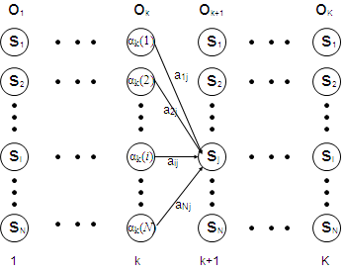
Trellis representation of an HMM
o_{m}
O_{m+1}
Therefore, we can write,
α_{m+1}(j)= P(o₁ o₂ ... o_{m+1 ,} q_{m+1}= s_{j} )
=Σ_{i} P(o₁ o₂ ... o_{m+1 ,}q_{m}= s_{i ,} q_{m+1}=s_{j})
=Σ_{i} P(o₁ o₂ ...o_{m ,} q_{m}= s_{i}) a_{ij} b_{j} (o_{m+1} )
=[Σ_{i} α_{m}(i) a_{ij} ] b_{j} (o_{m+1} ) ,
for 1<=j<=N, 1<=m<=K-1.
m
m+1

Slide 16
Trellis representation of an HMM
o_{m}
O_{m+1}
m
m+1
Now P(o₁ o₂ ... o_{K})
can be written as Σ_{i} P(o₁ o₂ ... o_{K ,} q_{K}= s_{i}) = Σ_{i} α_{K}(i)

Slide 17
Forward recursion for HMM
Initialization:
α₁(i)= P(o_{1 ,} q₁= s_{i} ) = π_{i} b_{i} (o₁) , 1<=i<=N.
Forward recursion:
α_{m+1}(j) = [Σ_{i} α_{m}(i) a_{ij} ] b_{j} (o_{m+1} ) , 1<=j<=N, 1<=m<=K-1.
Termination:
P(o₁ o₂ ... o_{K}) = Σ_{i} α_{K}(i)
Complexity :
N²K operations.

Slide 18
Backward recursion for HMM
Define the backward variable β_{m}(j) as the conditional probability of
  the partial observation sequence o_{m+1} o_{m+2} ... o_{K}
  given that the hidden state at time m is s_{j} :
  β_{m}(j)= P(o_{m+1} o_{m+2} ... o_{K} |q_{m}= s_{j} )

Slide 19
Backward recursion for HMM
Define β_{m}(j) in terms of β_{m+1}(i)’s:
β_{m+1}(i) is the conditional probability of
  the partial observation sequence o_{m+2} o_{m+3} ... o_{K}
  given that the hidden state at time m+1 is s_{i} :
  β_{m+1}(i)= P(o_{m+2} o_{m+3} ... o_{K} |q_{m+1}= s_{i} )

Slide 20
Backward recursion for HMM
Define β_{m}(j) in terms of β_{m+1}(i)’s: the probability of
where β_{m+1}(i)= P(o_{m+2} o_{m+3} ... o_{K} |q_{m+1}= s_{i} )
Now,
β_{m}(j)= P(o_{m+1} o_{m+2} ... o_{K} | q_{m}= s_{j} )
= Σ_{i} P(o_{m+1} o_{m+2} ... o_{K ,} q_{m+1}= s_{i} | q_{m}= s_{j} )
= Σ_{i} P(o_{m+2} o_{m+3} ... o_{K} | q_{m+1}= s_{i}) a_{ji} b_{i} (o_{m+1} )
= Σ_{i} β_{m+1}(i) a_{ji} b_{i} (o_{m+1} ) , 1<=j<=N, 1<=m<=K-1.

Slide 21
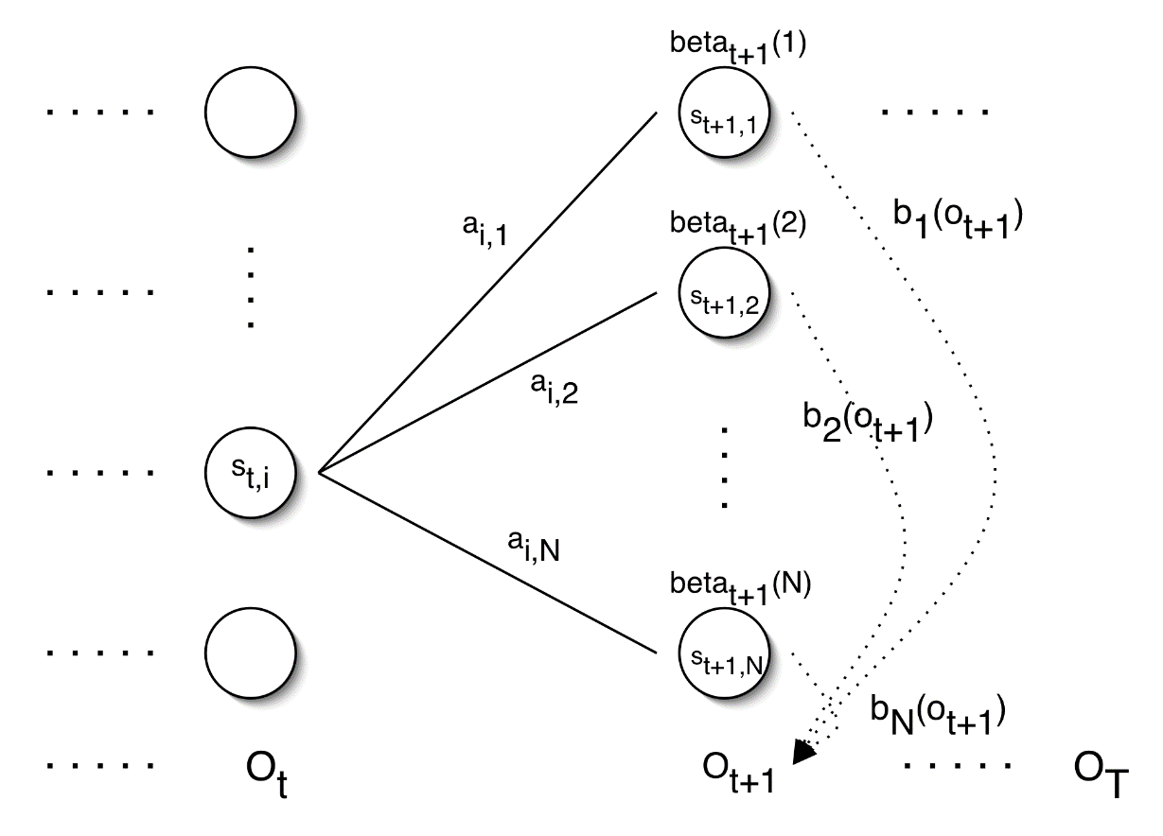
Backward recursion for HMM
= Σ_{i} P(o_{m+1} o_{m+2} ... o_{K ,} q_{m+1}= s_{i} | q_{m}= s_{j} )
= Σ_{i} P(o_{m+2} o_{m+3} ... o_{K} | q_{m+1}= s_{i}) a_{ji} b_{i} (o_{m+1} )
= Σ_{i} β_{m+1}(i) a_{ji} b_{i} (o_{m+1} ) , 1<=j<=N, 1<=m<=K-1.
β_{m+1}(1)
b₁(O_{m+1})
β_{m+1}(2)
b₂(O_{m+1})
β_{m}(j)
β_{m+1}(N)
b_{N}(O_{m+1})
o_{m}
O_{m+1}
o_{K}

Slide 22
Backward recursion for HMM
Initialization:
β_{K}(i)= 1 , 1<=i<=N.
Backward recursion:
β_{m}(j)= Σ_{i} β_{m+1}(i) a_{ji} b_{i} (o_{m+1} ) , 1<=j<=N, 1<=m<=K-1.
Termination:
P(o₁ o₂ ... o_{K}) = Σ_{i} P(o₁ o₂ ... o_{K ,} q₁= s_{i}) =
Σ_{i} P(o₁ o₂ ... o_{K} |q₁= s_{i}) P(q₁= s_{i}) = Σ_{i} β₁(i) b_{i} (o₁) π_{I}

Slide 23
Main issues using HMMs (2)
Decoding problem.
Given the HMM M=(A, B, π) and the observation sequence O=o₁ o₂ ... o_{K} , calculate the most likely sequence of hidden states s_{i} that produces this observation sequence O.
O=o₁...o_{K} denotes a sequence of observations o_{k}∈{v₁,…,v_{M}}.

Slide 24
Decoding problem
Given the HMM M=(A, B, π) and the observation sequence O=o₁ o₂ ... o_{K} , calculate the most likely sequence of hidden states s_{i} that produces this observation sequence O.
We want to find:
the state sequence Q= q₁…q_{K} maximizing
P(Q | o₁ o₂ ... o_{K} )

Slide 25
Decoding problem
Given the HMM M=(A, B, π) and the observation sequence O=o₁ o₂ ... o_{K} , calculate the most likely sequence of hidden states s_{i} that produces this observation sequence O.
We want to find:
the state sequence Q= q₁…q_{K} maximizing
P(Q | o₁ o₂ ... o_{K} )
or, equivalently
P(Q , o₁ o₂ ... o_{K} )

Slide 26
Decoding problem
Find max value of P(Q , o₁ o₂ ... o_{K} )
Brute Force Method:
Try for all possible sequences of states
N^{K} possible sequences for Q

Slide 27
Decoding problem
Use efficient Viterbi algorithm instead
Define variable δ_{m}(i) as the maximum probability of
  producing observation sequence o₁ o₂ ... o_{m}
  when moving along any hidden state sequence q₁… q_{m-1} and
  getting into q_{m}= s_{i}

Slide 28
Decoding problem
Use efficient Viterbi algorithm instead
Define variable δ_{m}(i) as the maximum probability of
  producing observation sequence o₁ o₂ ... o_{m}
  when moving along any hidden state sequence q₁… q_{m-1} and
  getting into q_{m}= s_{i}
Therefore, δ_{m}(i) = max P(q₁… q_{m-1} , q_{m}= s_{i} , o₁ o₂ ... o_{m})
where max is taken over all possible paths q₁… q_{m-1} .

Slide 29
Decoding problem
General idea:
if best path ending in q_{m}= s_{j} goes through q_{m-1}= s_{i} then it should coincide with best path ending in q_{m-1}= s_{i} .
q_{m-1} q_{m}
s₁
a_{1j}
s_{i}
s_{j}
a_{ij}
s_{N}
a_{Nj}

Slide 30
Decoding problem
General idea:
if best path ending in q_{m}= s_{j} goes through q_{m-1}= s_{i} then it should coincide with best path ending in q_{m-1}= s_{i} .
q_{m-1} q_{m}
s₁
a_{1j}
s_{i}
s_{j}
a_{ij}
s_{N}
a_{Nj}
δ_{m}(j) = max P(q₁… q_{m-1} , q_{m}= s_{j} , o₁ o₂ ... o_{m})

Slide 31
Decoding problem
General idea:
if best path ending in q_{m}= s_{j} goes through q_{m-1}= s_{i} then it should coincide with best path ending in q_{m-1}= s_{i} .
q_{m-1} q_{m}
s₁
a_{1j}
s_{i}
s_{j}
a_{ij}
s_{N}
a_{Nj}
δ_{m}(j) = max P(q₁… q_{m-1} , q_{m}= s_{j} , o₁ o₂ ... o_{m})
= max_{i} [ a_{ij} b_{j} (o_{m} ) max P(q₁… q_{m-1}= s_{i} , o₁ o₂ ... o_{m-1}) ]

Slide 32
Decoding problem
General idea:
if best path ending in q_{m}= s_{j} goes through q_{m-1}= s_{i} then it should coincide with best path ending in q_{m-1}= s_{i} .
q_{m-1} q_{m}
s₁
a_{1j}
s_{i}
s_{j}
a_{ij}
s_{N}
a_{Nj}
δ_{m}(j) = max P(q₁… q_{m-1} , q_{m}= s_{j} , o₁ o₂ ... o_{m})
= max_{i} [ a_{ij} b_{j} (o_{m} ) max P(q₁… q_{m-1}= s_{i} , o₁ o₂ ... o_{m-1}) ]
= max_{i} [ a_{ij} b_{j} (o_{m} ) δ_{m-1}(i)]

Slide 33
Decoding problem
General idea:
if best path ending in q_{m}= s_{j} goes through q_{m-1}= s_{i} then it should coincide with best path ending in q_{m-1}= s_{i} .
q_{m-1} q_{m}
s₁
a_{1j}
s_{i}
s_{j}
a_{ij}
s_{N}
a_{Nj}
To backtrack best path, keep info that predecessor of s_{j} was s_{i}.

Slide 34
Decoding problem
Initialization:
δ₁(i) = max P(q₁= s_{i} , o₁) = π_{i} b_{i} (o₁) , 1<=i<=N
Forward recursion:
δ_{m}(j) = max_{i} [ a_{ij} b_{j} (o_{m} ) δ_{m-1}(i) ] , 1<=j<=N, 2<=m<=K.
Termination: choose best path ending at time K
max_{i} [ δ_{K}(i) ]
Backtrack best path.

Slide 35
Issues in HMMs (3)
Learning/Training problem.
Given some training observation sequences O=o₁ o₂ ... o_{K} and general structure of HMM (numbers of hidden and visible states), determine HMM parameters M=(A, B, π) that best fit training data.
O=o₁..., o_{m},...,o_{K} denotes a sequence of observations
where, o_{m}∈{v₁,…,v_{M}}.

Slide 36
Learning/Training Problem
Given some training observation sequences O=o₁ o₂ ... o_{K} and general structure of HMM (numbers of hidden and visible states), determine HMM parameters M=(A, B, π) that best fit training data.
There is no algorithm producing optimal parameter values.

Slide 37
Learning/Training Problem
Given some training observation sequences O=o₁ o₂ ... o_{K} and general structure of HMM (numbers of hidden and visible states), determine HMM parameters M=(A, B, π) that best fit training data.
There is no algorithm producing optimal parameter values.
Use iterative Expectation-Maximization (EM) algorithm to find local maximum of P(O | M) - Baum-Welch algorithm.

Slide 38
Learning/Training Problem
Idea of EM :
Initialization: Assume initial value of A, B, π
and calculate P(O | M)
E-step:
Estimate new values of the model parameters: A, B, π
from the previous values of A, B, π
M-step:
Find P(O | M) with the new values of A, B, π
Repeat these steps until P(O | M) declines

Slide 39
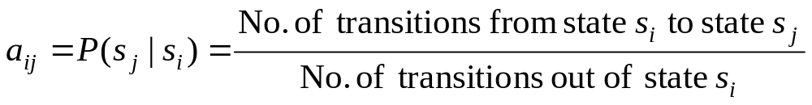
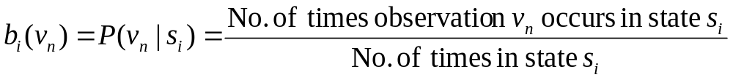
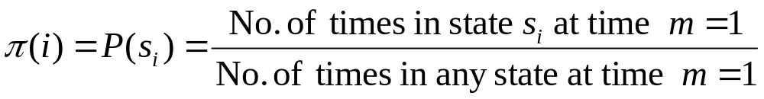
Learning/Training Problem
we need to calculate the following parameters:

Slide 40
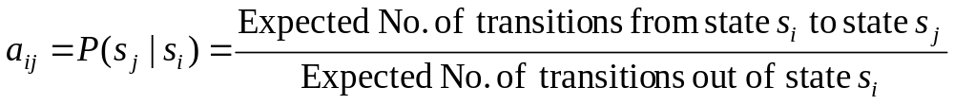
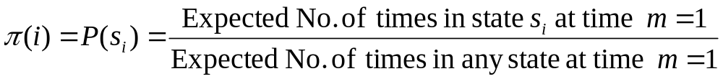
Baum-Welch algorithm
the algorithm estimates the expected value::

Slide 41
Baum-Welch algorithm
Define variable ξ_{m}(i,j) as the probability of being in state s_{i} at time m and in state s_{j} at time m+1, given the observation sequence o₁ o₂ ... o_{K} .
ξ_{m}(i,j)= P(q_{m}= s_{i} , q_{m+1}= s_{j} | o₁ o₂ ... o_{K})

Slide 42
Baum-Welch algorithm
Define variable ξ_{m}(i,j) as the probability of being in state s_{i} at time m and in state s_{j} at time m+1, given the observation sequence o₁ o₂ ... o_{K} .
ξ_{m}(i,j)= P(q_{m}= s_{i} , q_{m+1}= s_{j} | o₁ o₂ ... o_{K})
P(q_{m}= s_{i} , q_{m+1}= s_{j} , o₁ o₂ ... o_{K})
P(o₁ o₂ ... o_{K})
ξ_{m}(i,j)=

Slide 43
Baum-Welch algorithm
Define variable ξ_{m}(i,j) as the probability of being in state s_{i} at time m and in state s_{j} at time m+1, given the observation sequence o₁ o₂ ... o_{K} .
ξ_{m}(i,j)= P(q_{m}= s_{i} , q_{m+1}= s_{j} | o₁ o₂ ... o_{K})
P(q_{m}= s_{i} , q_{m+1}= s_{j} , o₁ o₂ ... o_{K})
P(o₁ o₂ ... o_{K})
ξ_{m}(i,j)=
P(q_{m}= s_{i} , o₁ o₂ ... o_{m}) a_{ij} b_{j} (o_{m+1} ) P(o_{m+2} ... o_{K} | q_{m+1}= s_{j} )
P(o₁ o₂ ... o_{K})
=

Slide 44
Baum-Welch algorithm
Define variable ξ_{m}(i,j) as the probability of being in state s_{i} at time m and in state s_{j} at time m+1, given the observation sequence o₁ o₂ ... o_{K} .
ξ_{m}(i,j)= P(q_{m}= s_{i} , q_{m+1}= s_{j} | o₁ o₂ ... o_{K})
P(q_{m}= s_{i} , o₁ o₂ ... o_{m}) a_{ij} b_{j} (o_{m+1} ) P(o_{m+2} ... o_{K} | q_{m+1}= s_{j} )
P(o₁ o₂ ... o_{K})
=
α_{m}(i) a_{ij} b_{j} (o_{m+1} ) β_{m+1}(j)
P(o₁ o₂ ... o_{K})
=

Slide 45
Baum-Welch algorithm
Define variable γ_{m}(i) as the probability of being in state s_{i} at time m, given the observation sequence o₁ o₂ ... o_{K} .
γ_{m}(i)= P(q_{m}= s_{i} | o₁ o₂ ... o_{K})
P(q_{m}= s_{i} , o₁ o₂ ... o_{k})
P(o₁ o₂ ... o_{k})
α_{m}(i) β_{m}(i)
P(o₁ o₂ ... o_{k})
γ_{m}(i)=
=

Slide 46
Baum-Welch algorithm
We calculated ξ_{m}(i,j) = P(q_{m}= s_{i} , q_{m+1}= s_{j} | o₁ o₂ ... o_{K})
and γ_{m}(i)= P(q_{m}= s_{i} | o₁ o₂ ... o_{K})
Expected number of transitions from state s_{i} to state s_{j}
= Σ_{m} ξ_{m}(i,j)
Expected number of transitions out of state s_{i} = Σ_{m} γ_{m}(i)
Expected number of times observation v_{n} occurs in state s_{i} =
= Σ_{m} γ_{m}(i) , m is such that o_{m}= v_{n}

Slide 47
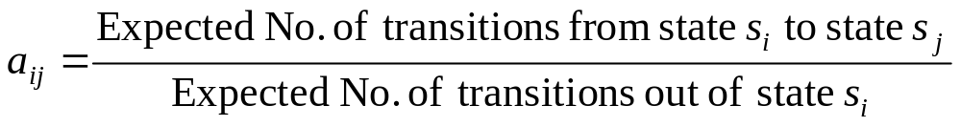
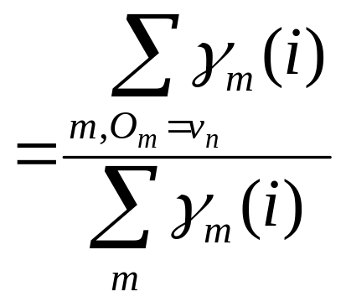
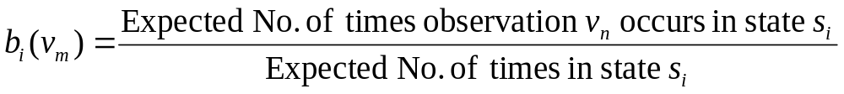
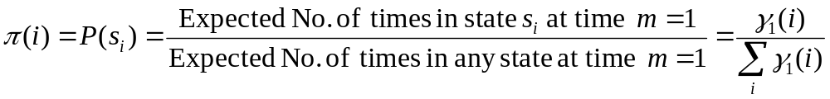
Baum-Welch algorithm: E-Step
Estimate the expected values as
Σ_{m} ξ_{m}(i,j)
Σ_{m} γ_{m}(i)
=

Slide 48
Learning/Training Algorithm
Initialization: Assume initial value of A, B, π
and calculate P(O | M)
E-step:
Estimate new values of the model parameters: A, B, π
from the previous values of A, B, π
M-step:
Find P(O | M) with the new values of A, B, π
Repeat these steps until P(O | M) declines

